Slide 1
Java Applet

Slide 2
Applet is a Java program that can be embedded into a web page
It runs inside the web browser and works at client side.
Applet is embedded in a HTML page using the APPLET or OBJECT tag and hosted on a web server.
Applets are used to make the web site more dynamic and entertaining.

Slide 3
Features of Java Applets
All applets are subclasses of Applet class.
all applets must import java.applet.
Applets must also import java.awt.
Applet class provides the standard interface between the applet and the browser environment.
do not use the main() method for initiating the execution of the code.

Slide 4
applet cannot be run independently- They run from inside a webpage using HTML tag.
they run within either a web browser or an applet viewer.
JDK provides a standard applet viewer tool called applet viewer.
Output of an applet window is handled with various AWT methods, such as drawString().

Slide 5
A JVM is required to view an applet.
The JVM on the user's machine creates an instance of the applet class and invokes various methods during the applet's lifetime.

Slide 6
Advantage of Applet
It works at client side so less response time.
Secured
It can be executed by browsers running under many platforms, including Linux, Windows, Mac Os etc.
Drawback of Applet
Plugin is required at client browser to execute applet.

Slide 7
Two Types of Applets
Based directly on the Applet class.
These applets use the Abstract Window Toolkit (AWT) to provide the graphical user interface
available since Java was first created
based on the Swing class Japplet
which inherits Applet.
use the Swing classes to provide the GUI.
a richer and often easier-to-use user interface

Slide 8
Life cycle of an Applet
When an applet begins, the following methods are called, in this sequence:
1. init( )
2. start( )
3. paint( )
When an applet is terminated, the following sequence of method calls takes place:
1. stop( )
2. destroy( )

Slide 9
init( )
first method to be called
where you should initialize variables.
method is called only once during the run time of your applet.-- the first time an applet is loaded
start( )
called after init( ).
also called to restart an applet after it has been stopped.
called each time an applet’s HTML document is displayed onscreen- applet resumes execution at start( ).

Slide 10
paint( )
called each time an AWT-based applet’s output must be redrawn.
paint( ) method has one parameter of type Graphics.- describes the graphics environment in which the applet is running.
stop( )
called when a web browser leaves the HTML document containing the applet
use stop( ) to suspend threads that don’t need to run when the applet is not visible.
can restart them when start( )

Slide 11
destroy( )
called when the environment determines that your applet needs to be removed completely from memory.
free up any resources the applet may be using.
stop( ) method is always called before destroy( ).
Overriding update( )
called when your applet has requested that a portion of its window be redrawn
default version of update( ) simply calls paint( ).

Slide 12
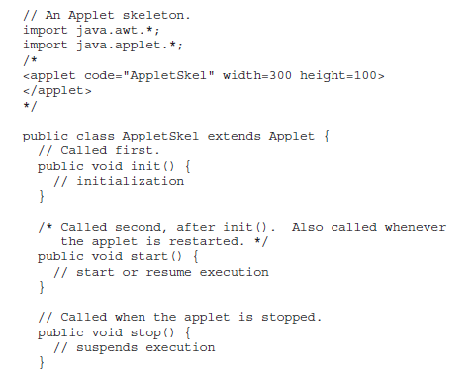
Applet Skeleton

Slide 13
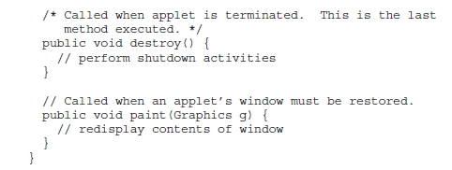

Slide 14
Creating Applets
Creating Hello World applet:
// Save file as HelloWorld.java
import java.applet.Applet;
import java.awt.Graphics;
public class HelloWorld extends Applet
// HelloWorld class extends Applet
{
public void paint(Graphics g)
// Overriding paint() method @Override
{
g.drawString("Hello World", 20, 20);
}
}

Slide 15
void drawString(String message, int x, int y)
In a Java window, the upper-left corner is
location 0,0.
an applet begins execution when the name of its class is passed to an applet viewer or to a network browser.

Slide 16
Running the HelloWorld Applet:
Compile using javac command.
two ways to run an applet
1. By html file (web browser).
2. By appletViewer tool (for testing purpose).

Slide 17
Using web browser:
Steps:
create an applet and compile it.
After that create an html file and place the applet code in html file.
click the html file.

Slide 18
//myapplet.html
<html>
<body>
<applet code=" HelloWorld.class" width="300" height="300"></applet>
</body>
</html>
width and height statements specify the dimensions of the display area used by the applet.

Slide 19
Using appletviewer :
Steps:
create an applet that contains applet tag in comment.
compile it.
Html file is not required.

Slide 20
// Save file as HelloWorld.java
// A Hello World Applet Using appletviewer
import java.applet.Applet;
import java.awt.Graphics;
/*
<applet code="HelloWorld" width=200 height=60></applet>
*/
public class HelloWorld extends Applet
// HelloWorld class extends Applet
{
public void paint(Graphics g)
{
g.drawString("Hello World", 20, 20);
}
}

Slide 21
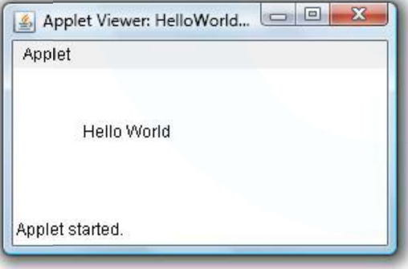
To execute the applet by appletviewer tool, write in command prompt:
c:\>javac HelloWorld.java
c:\>appletviewer HelloWorld.java

Slide 22
The HTML APPLET Tag
APPLET tag is used to start an applet from both an HTML document and from an applet viewer.
An applet viewer will execute each APPLET tag that it finds in a separate window
web browsers will allow many applets on a single page.

Slide 23
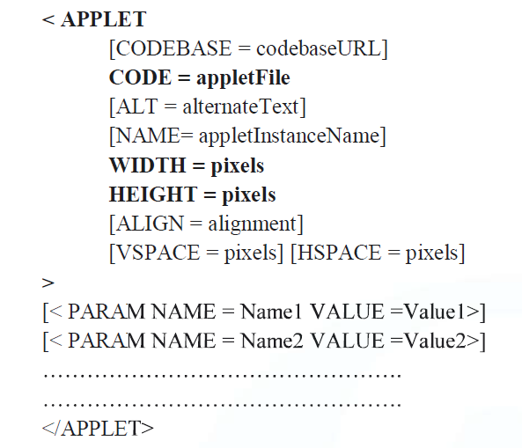
The syntax for the standard APPLET tag

Slide 24
CODEBASE:
optional attribute
specifies the base URL of the applet code
(directory that contains applets executable code)
CODE:
required attribute
name of the file containing your applet’s compiled .class file.
ALT
optional attribute
specify a short text message that should be displayed if the browser recognizes the APPLET tag but can’t currently run Java applets.

Slide 25
NAME:
optional attribute
specify a name for the applet instance.
WIDTH AND HEIGHT:
required attributes
give the size (in pixels) of the applet display area.
ALIGN:
optional attribute
specifies the alignment of the applet.
VSPACE AND HSPACE:
attributes are optional.
VSPACE specifies the space, in pixels, above and below the applet.
HSPACE specifies the space, in pixels, on each side

Slide 26
PARAM NAME AND VALUE:
The PARAM tag allows you to specify applet-specific arguments.
Applets access their attributes with the getParameter( ) method.

Slide 27
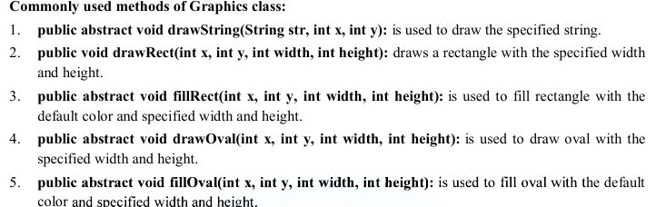
Displaying Graphics in Applet
java.awt.Graphics class provides many methods for graphics programming.

Slide 28
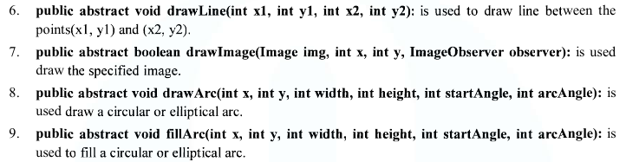


Slide 29
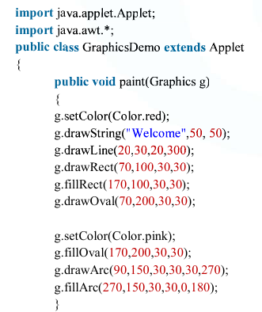
Example of Graphics in applet:
}

Slide 30
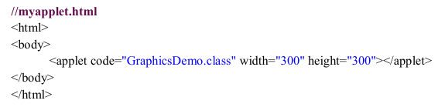

Slide 31
Passing Parameters to Applets
The APPLET tag in HTML allows us to pass parameters to an applet.
To retrieve a parameter, the getParameter( ) method is used.
It returns the value of the specified parameter in the form of a String object.
for numeric and Boolean values, we need to convert their string representations into their internal formats.

Slide 32
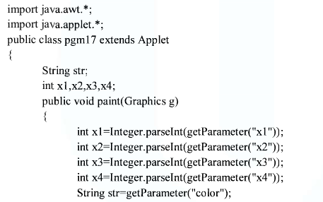

Slide 33
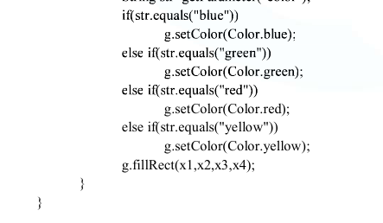

Slide 34
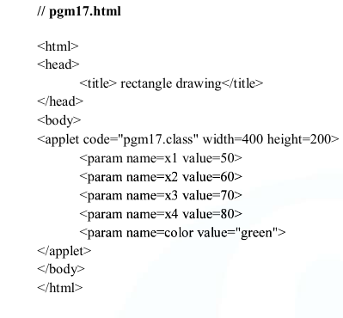

Slide 35
